Slide 1
H1B Dataset Analysis
—— Group 18: Zili Bu, Mengxin Tan
Junyi Qian, Michael Lombardo

Slide 2
Introduction
Position Related
Wage Related
eg: temporary or permanent labor condition
eg: prevailing wage
H1B Case
Employer Related
Case Related
eg: willful violator
eg: submission date
Labor condition application
Foreign Labor Certification Office
Notes:
Data is from the Office of Foreign Labor Certification which is a division of the Department of Labor. The office is responsible for enforcing certain labor conditions and laws before employers can hire foreign workers. The most common mission is to verify whether foreign workers are qualified to obtain H1B visa..
The dataset can be easily divided into 4 dimensions which are Wage, Position, Employer and Case.all the information from the dataset ends in 2017. But all the decisions are made between 2016 and 2017.
We are aiming to analyze how these 4 dimensions influence the result of a H1B application and we believe that analyzing the contents of the labor condition application would be helpful for foreign students who are looking for jobs in United States.

Slide 3
Importance
Analyzing factors such as wage, employer, and the general visa application is helpful for foreign students, employers, and the US Government in a number of ways.
Importance to foreign students:
To understand the visa process.
To understand which employers create visa applications for their employees.
To understand average salaries by employer.
Importance to employers:
To understand competitors average salaries.
To understand competitors hiring efforts abroad.
Importance to the US Government:
To understand the quantity of approved visas and their location.

Slide 4
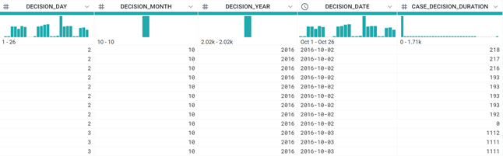
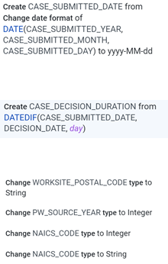
Wrangling
Notes:
We face some challenges of this dataset. For example, we do not have enough data for cases that have decisions on 2015 and before. And due to privacy issues we cannot have access to the exact reason of one case being denied or withdrawn. But for data wrangling, basically, we did some data cleaning process. For starters, we remove some rows with missing or mismatched values which are few that are not gonna affect the whole dataset. Then we merged the date as the normal date type, which are originally displayed separately as Day, Month, Year. Also, we calculate the difference between the case_submitted_date and case_decision_date as our case_decision_duration of one case being inspected. We make the payment units consistent in Year and calculate the wage difference as one possible factor for application status. Those are what we have done to this dataset with Trifacta.

Slide 5

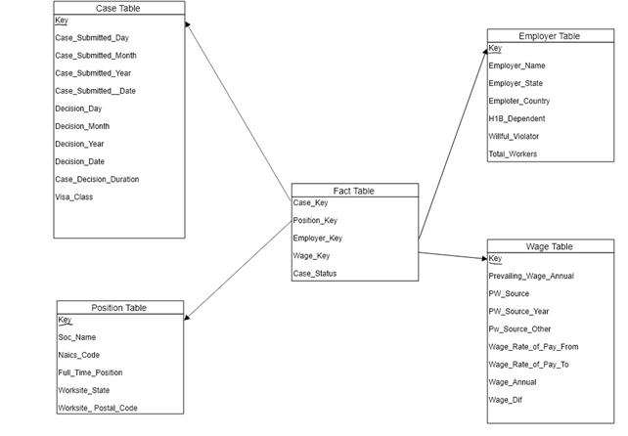
Schema
Notes:
Here is our Star Schema. We divide all the attributes into four dimensions and one fact. The four dimensions are case, position, employer and wage related information and the fact table consists of the four dimension keys and the case approval status.
The data provides hide the PK of our original table

Slide 6
How is status of a case affected by other data elements and can we identify a pattern in certification or denial of the visa applications?
Business Question 1

Slide 7
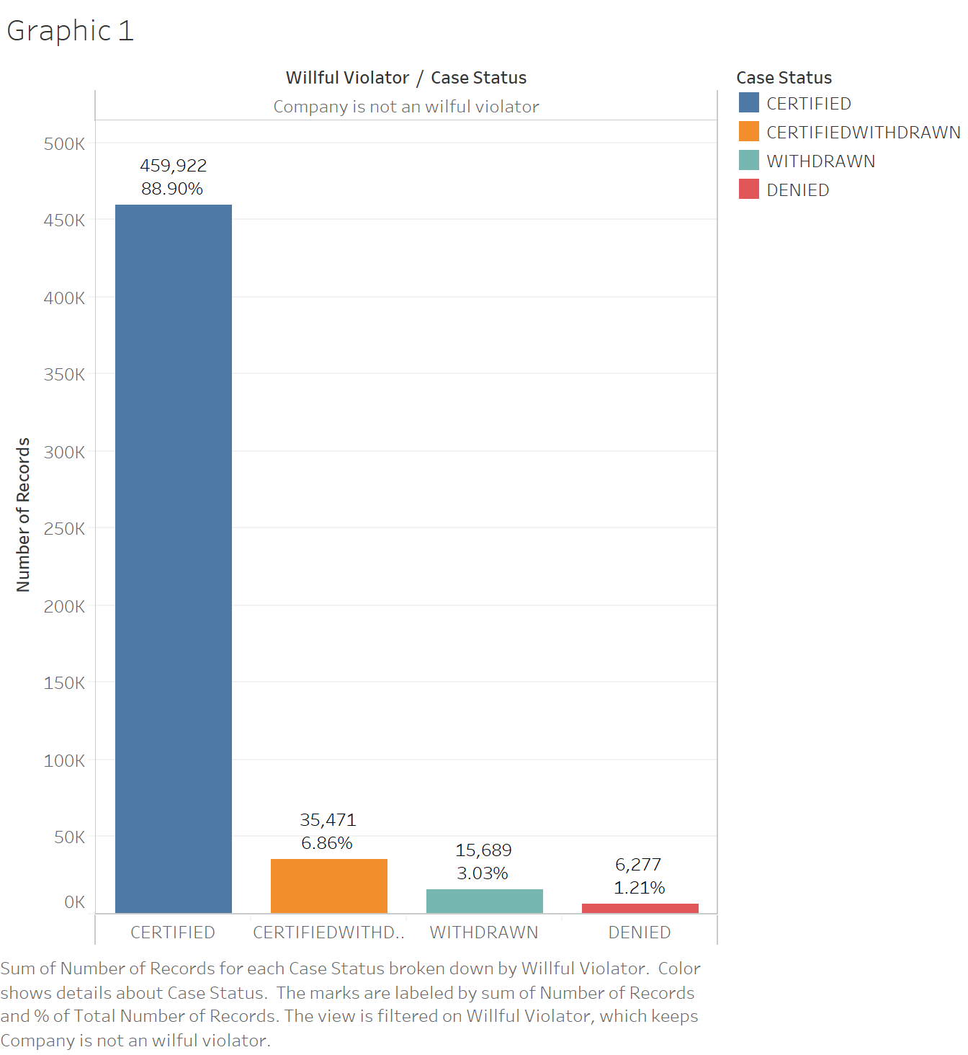
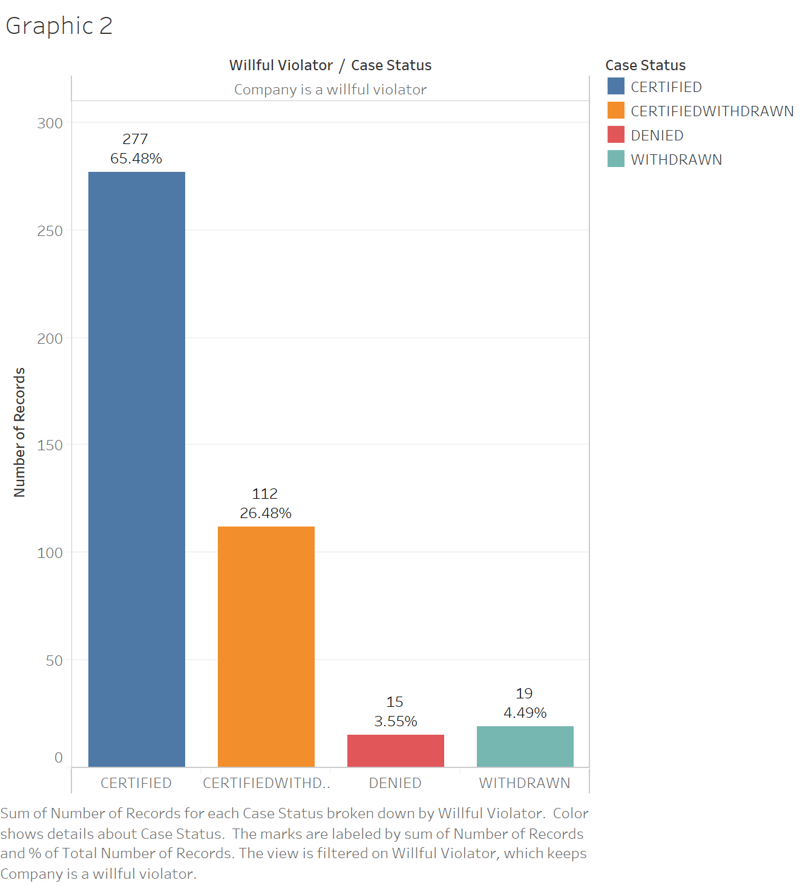
Notes:
Willful violator meaning:
A finding of violation by the employer is entered into either a Department of Labor or Department of Justice proceeding.
The agency finds that the employer has committed either a willful failure or a misrepresentation of a material fact
Willful violators are subject to random investigations by the Department of Labor for a period of up to five years from the date that the employer is determined to be a willful violator.
There are currently 25 total labelled willful violators.
https://www.dol.gov/whd/regs/compliance/FactSheet62/whdfs62S.htm
https://www.dol.gov/whd/immigration/H1BWillfulViolator.htm

Slide 8
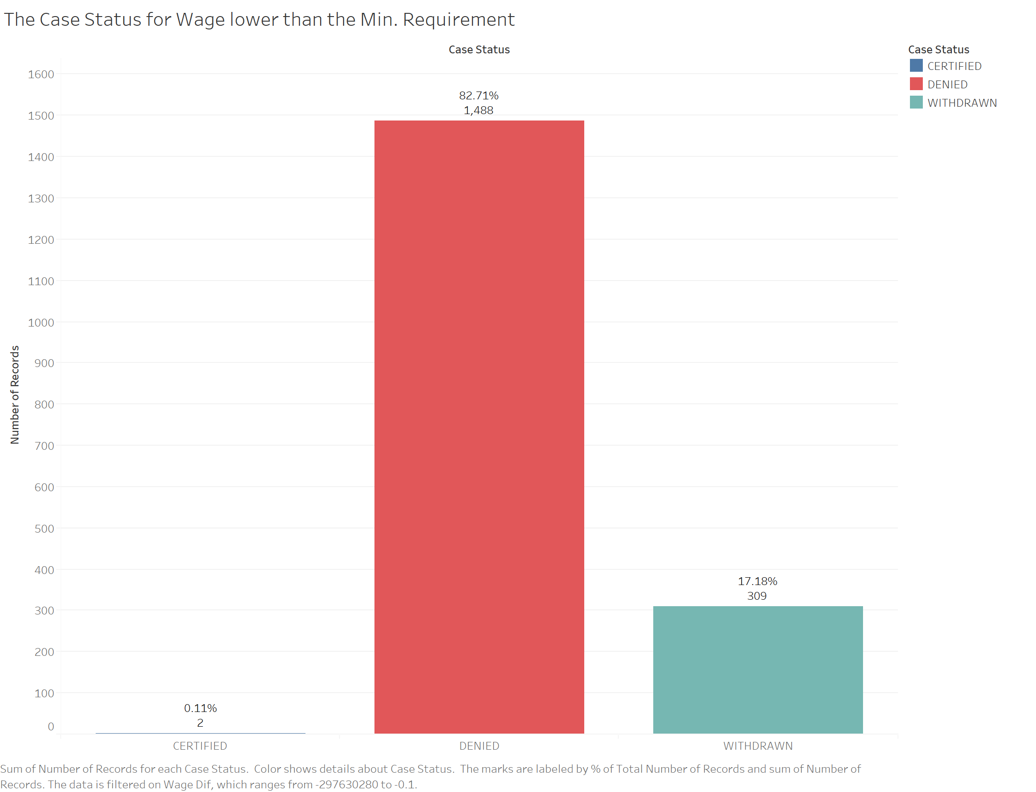
Notes:
Lastly we wanted to see if wage was a factor in denial. As we can see if employers submit an application with wage that is lower than the prevailing wage - which is a wage required by the government for a specific type of work - it is very likely to be denied or withdrawn. At the other end of the scale we also identified cases that had incorrectly been submitted with extremely high wages and those were similarly largely denied or withdrawn.

Slide 9
Business Question 2
How have the requests changed by year for the top companies?
Which industries do these companies work in?
How have the requests changed by year for top positions?

Slide 10
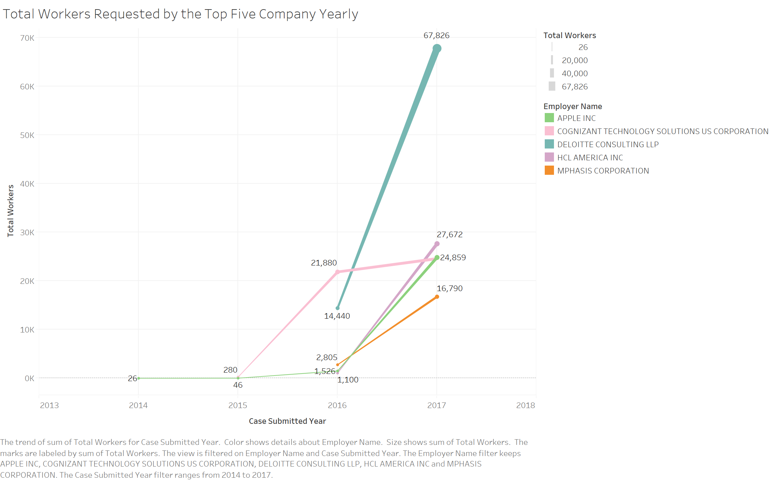
Notes:
Due to the lack of information, we can only see the data of Deloitte and Mphasis of year 2016 and 2017. But still, we find these top 5 companies with most workers and we list the worker number change in recent years. All of them have a upward trend. And it is obvious that the number of employees Apple, Deloitte and Cognizant recruited have a sharp increase from 2016 to 2017.

Slide 11
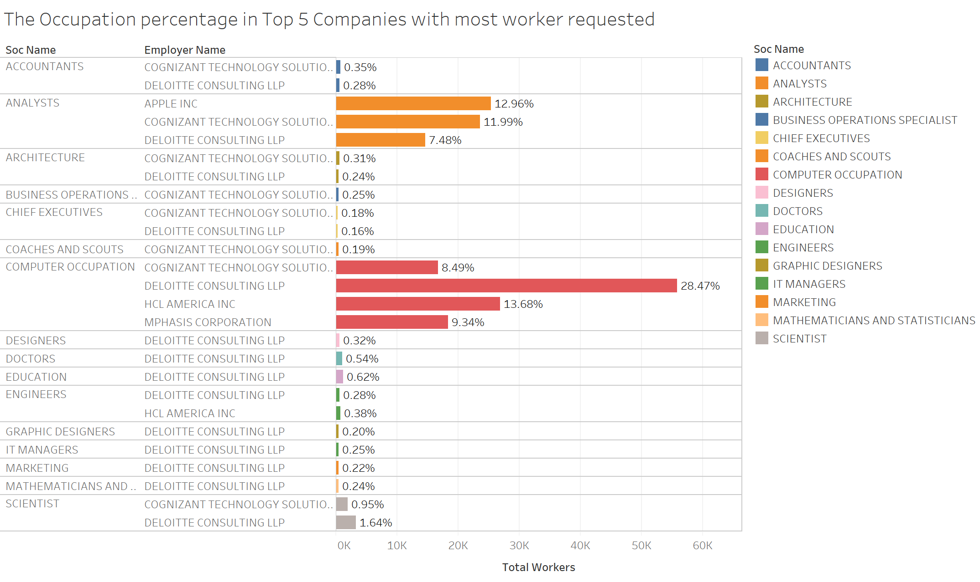
Notes:
Still, it is obvious that the five companies with most workers have their business in a very wide range, such as coaches and scouts, designers, education, and even architecture, although these are not the fields that these companies are famous of. Among all of the positions, analysts, computer-related and scientists have most workers without any question.

Slide 12
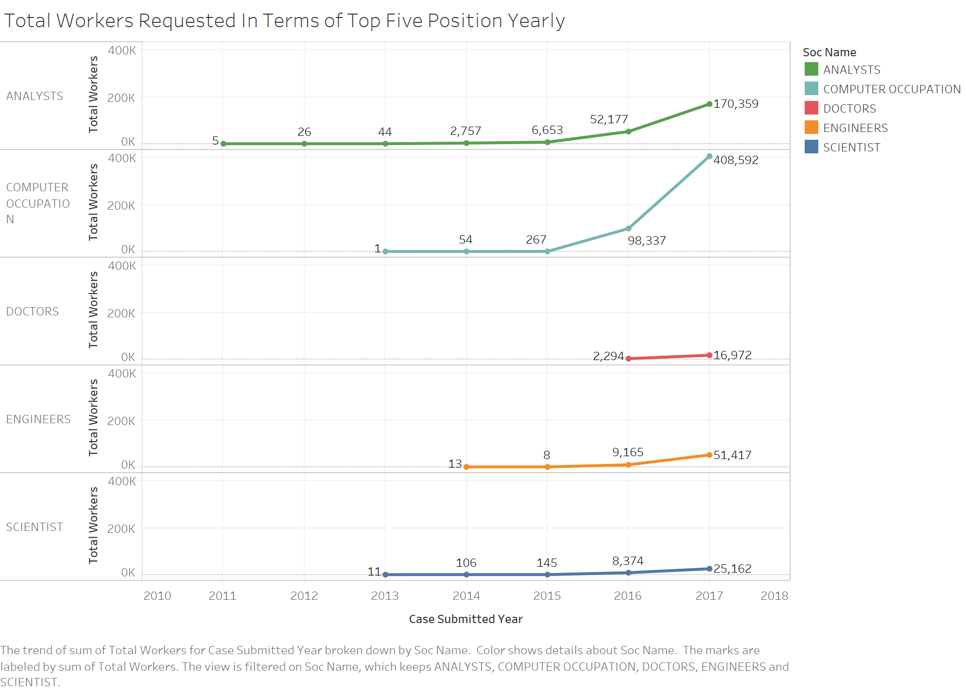
Notes:
As for different industries, first we pick up five industries with most labor demands, and we list them in terms of year. We can see that within this positions, the demands of labor all have an upward trend. What changes the most is the computer occupation and analysts.

Slide 13
Business Question 3
Which occupation offers the highest annual wages ?
How do the wages compare for competitors in the top occupations?
How do wages vary over location?
Notes:
All the cases below take from the approved applications

Slide 14
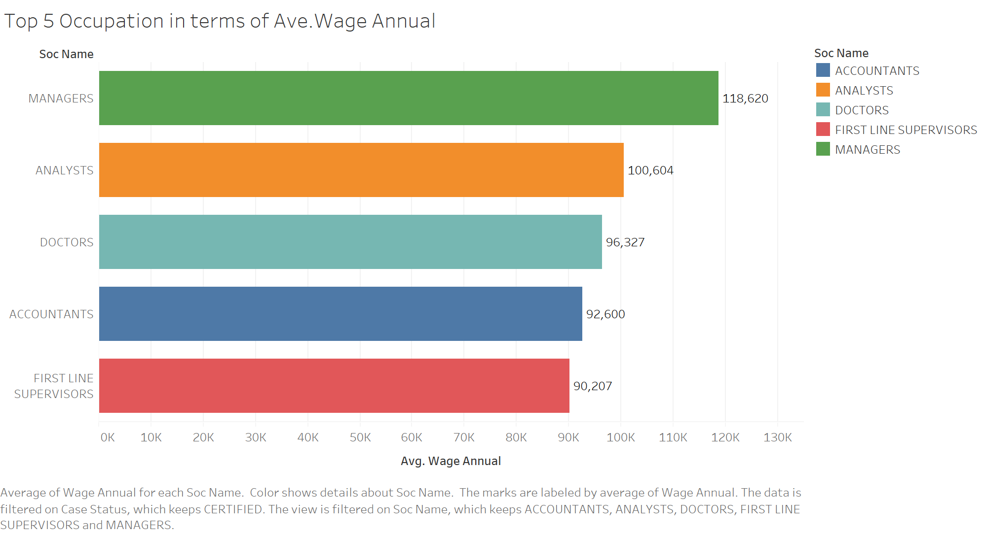
Notes:
Now we switch our focus on the average annual wage and find the top 5 occupation(soc_name).
The highest one is manager which is reasonable because these position requires more experiences and leadership ability.
The second highest is analysts which is a good news for all of us.
The limitation of this query is that we are not considering the number of applications and there might be some extreme values that affect the avg. wage value for some position

Slide 15
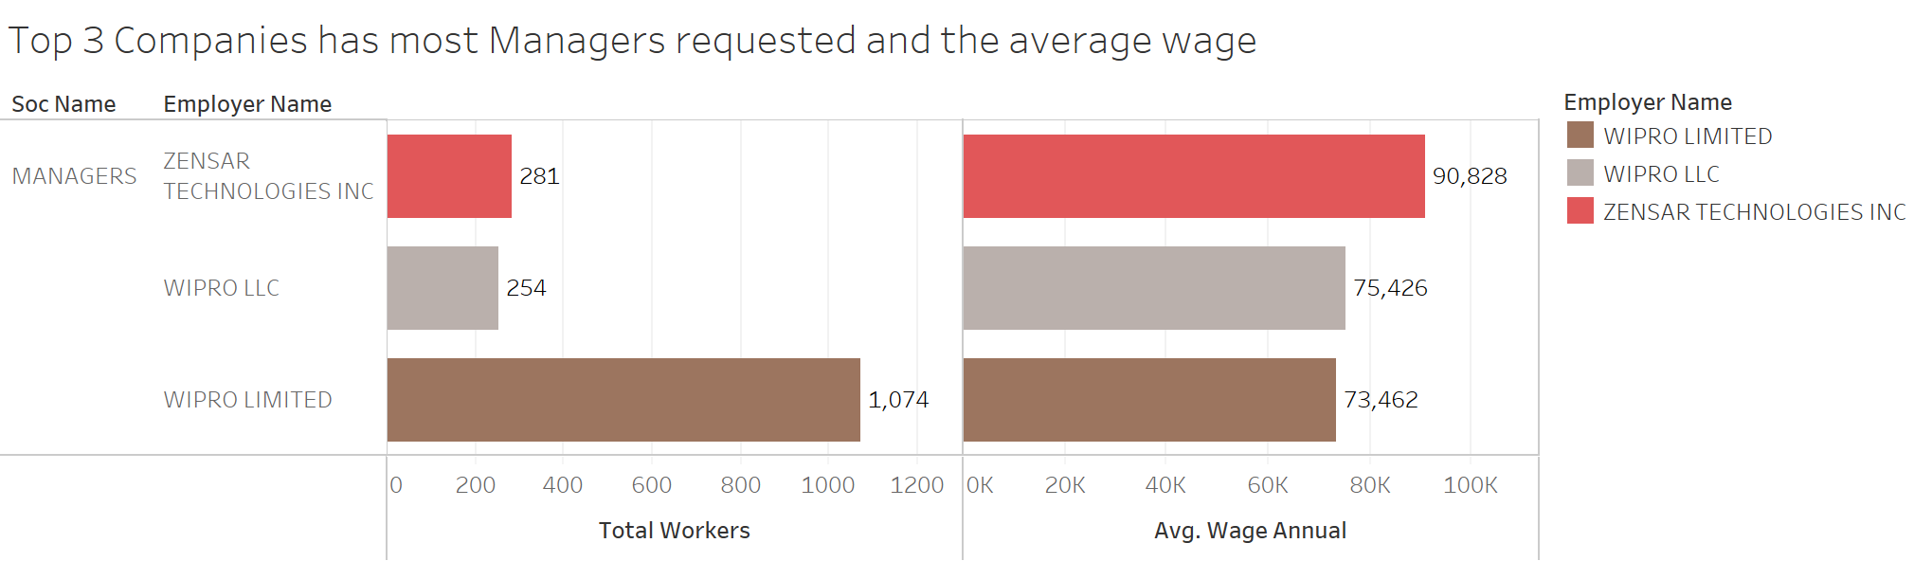
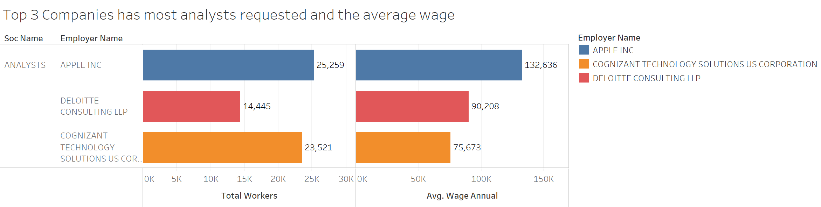
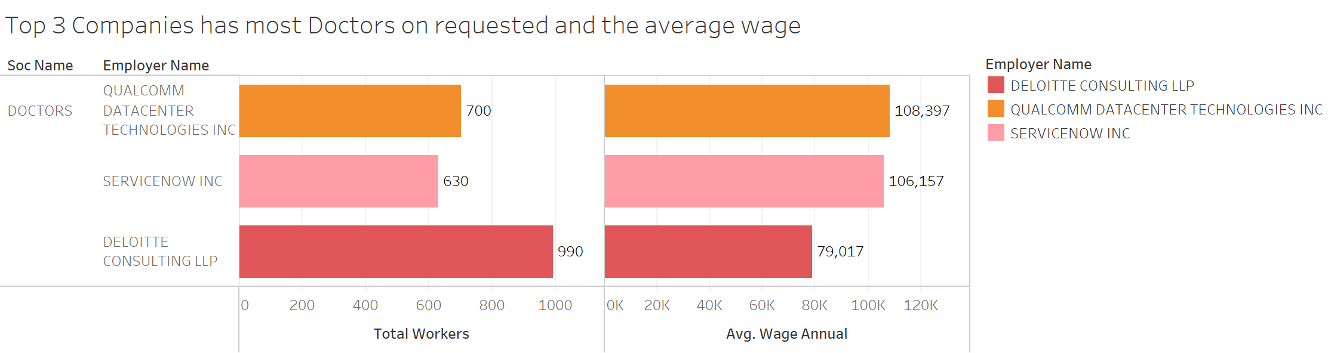
Notes:
Continuing on the top five occupation with most avg. annual wage, we pick up the top 3 occupation.
Then we look into the top 3 companies in terms of most worker requested for the each occupation, and also get their avg. annual wage.
We believe that companies can make this kind of analysis to get competitors wage offering and the number of workers requested.
However, the limitation is that the position is not well-defined. Like, an analysts can be financial or process or data field, that might explain the variance of the wage.

Slide 16
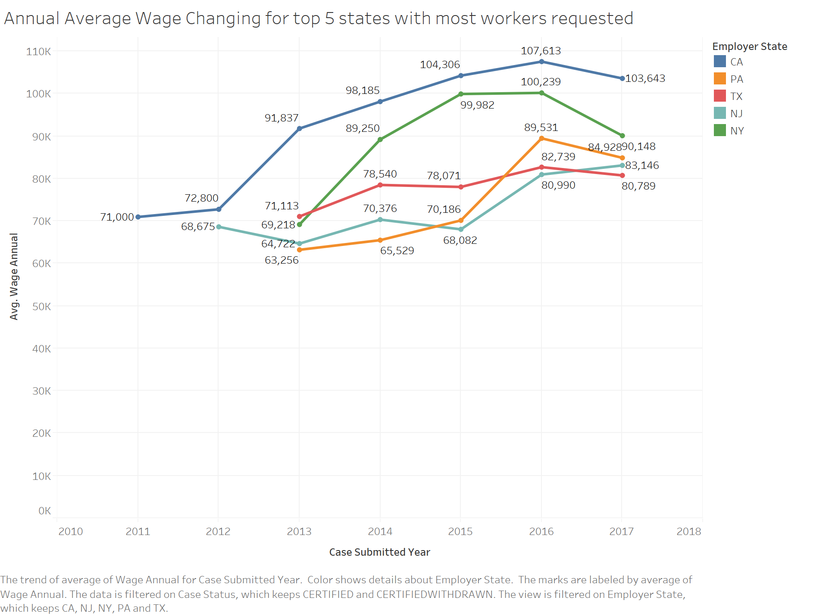
Notes:
Lastly, we get a query about the top five states with most workers requested and see their avg. wages changing through the year.
We can see a clear increasing trend from 2011 to 2016 in general, however, except NJ, others face a drop in wages after 2016.
In order to address the drop happened in 2016, we run a query about the minimum wage required by the government and all them drops in 2017. Therefore, companies can offer lower wages than before and that is one possible explanation for that.

Slide 17
Q&A

Slide 18
Back-up Slides

Slide 19
Case_Status
Certified
Withdrawn
Certified
Withdrawn
Denied
LCA of an employer was approved
case was withdrawn after it was certified by OFLC
case was withdrawn by the employer
case was denied by OFLC

Slide 20
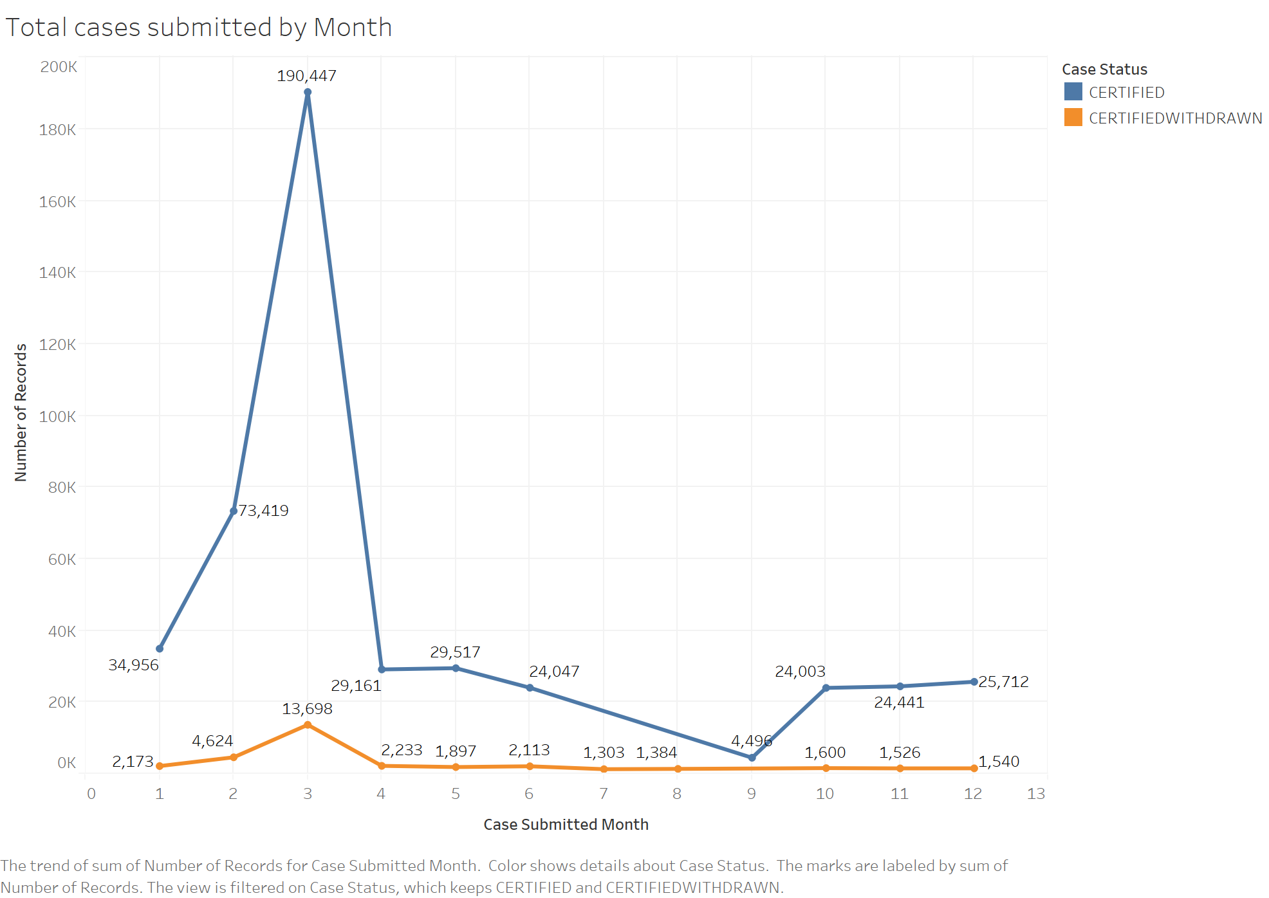
Notes:
Here we wanted to see the number of certified or certified and subsequently withdrawn applications by month. As we can see most are certified and also submitted in March because the due date for a fiscal years application is in April of each year.

